Slide 1

FPGA RSA EXPRESS
Group No: 65
Project Supervisor
Rajeshwari bhatt
Group Members
Nisha Chauhan 2000910310105
Nitin Singh 2000910310106
Riya Sharma 2000910310129
DEPARTMENT OF ELECTRONICS AND COMMUNICATION ENGINEERING

Slide 2
Project Presentation Outline
Title of the Project
Problem statement
Literature Survey
Objective
Block diagram
Software/Hardware
Pert Chart
References

Slide 3
Title of the Project:
FPGA RSA EXPRESS
DEPARTMENT OF ELECTRONICS & COMMUNICATION

Slide 4
Problem statement:
Achieving efficient and secure encryption/decryption is essential. RSA, a key algorithm, is slow when executed on software, especially with significant data or real-time demands. A hardware-based approach is required to accelerate RSA computations for better performance and effectiveness.
DEPARTMENT OF ELECTRONICS & COMMUNICATION

Slide 5
Literature Survey
RESEARCH PAPER | TITLE | GOALS
Chinese Journal of Electronics DING Yanyu, HU Jianguo, WANG Deming and TAN Hongzhou | A High-Performance RSA Coprocessor Based on Half-Carry-Save and Dual-Core MAC Architecture | To improve the throughput and lower the power for low-cost RSA coprocessors.
International Journal of Engineering Research & Technology (IJERT) Ankit Anand, Pushkar Praveen | Implementation of RSA Algorithm on FPGA | design and implementation of a flexible key RSA encryption
A. Miyamoto, N. Homma, T. Aoki, et al., | Systematic design of RSA processors based on high-radix Montgomery multipliers” | It presents a systematic design approach to provide the optimized (RSA) processors
M. Knezevic, F. Vercauteren and I. Verbauwhede | Faster interleaved modular multiplication based on Barrett and Montgomery reduction methods | This paper proposes two improved interleaved modular multiplication algorithms based on Barrett and Montgomery modular reduction
A.P. Renardy, N. Ahmadi, A.A. Fadila, et al., | Hardware implementation of Montgomery modular multiplication algorithm using iterative architecture | Implementation of digital modulators on Field Programmable Gate Array (FPGA)
A. Nadjia and A. Mohamed | High throughput parallel Montgomery modular exponentiation on FPGA | presents a new modular exponentiation architecture with a unified modular multiplication/square module
DEPARTMENT OF ELECTRONICS & COMMUNICATION

Slide 6
Objective of the Project
Efficient RSA Operations
Hardware Acceleration & Real-time Performance
Key Generation, Encryption, and Decryption (Security Integration)
Documentation and Presentation
DEPARTMENT OF ELECTRONICS & COMMUNICATION

Slide 7
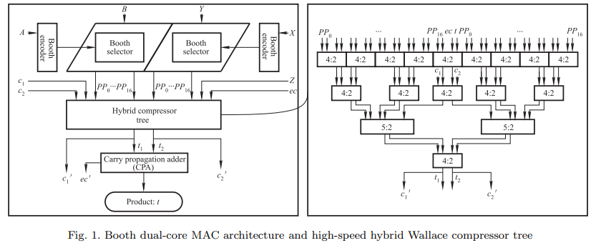
Block diagram of the Project.
DEPARTMENT OF ELECTRONICS & COMMUNICATION

Slide 8
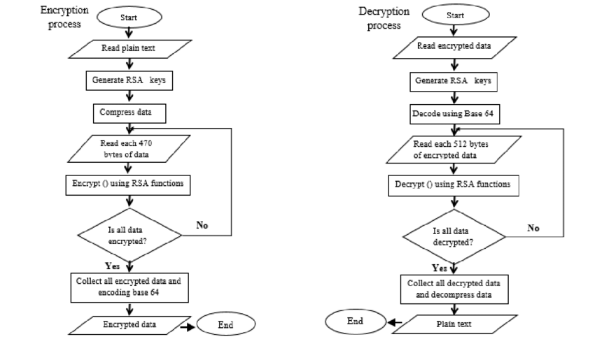
Methodology(Flow chart/ Work Flow /algorithms )
DEPARTMENT OF ELECTRONICS & COMMUNICATION

Slide 9
Software/Hardware
FPGA
Xilinx ISE
Verilog
DEPARTMENT OF ELECTRONICS & COMMUNICATION

Slide 10
REFERENCES / LIST OF ACCESSED RESOURCES:
https://ieeexplore.ieee.org/document/6021216
https://iopscience.iop.org/article/10.1088/1742-6596/1641/1/012042
https://scholarworks.calstate.edu/concern/
theses/76537633k?locale=en
https://www.ijser.org/researchpaper/
Implementation_of_RSA_Cryptosystem_Using_Verilog.pdf
DEPARTMENT OF ELECTRONICS & COMMUNICATION

